Slide 1
Opening a New Pizza Place in Washington, D.C
Aishwarya Nair
IBM Capstone Project

Slide 2
Business Problem
Location is one of the important parameters that decide whether the opening of a pizza place will be success or failure.
Objective: Analyze the neighborhoods in Washington, D.C. and select the best location to open a Pizza Place.
The place should not have many Sushi Shops around to avoid competition and must be a rich neighborhood for best profits.

Slide 3
Data Description
Neighborhoods in Washington, D.C: https://en.wikipedia.org/wiki/Neighborhoods_in_Washington,_D.C.
The coordinates of these neighborhoods from Open Street Map APIs
Extract following venues data from FourSquare API
Pizza Place in the neighborhoods
College & University
Offices

Slide 4
Methodology
Scraped Wikipedia page for neighborhoods in Washington, D.C.
Obtained the geographical coordinates of these neighborhoods from Open Street Map API
Used FourSquare API to retrieve nearby venue locations
Calculated the weighted sum for each neighborhood to determine the best location
Plotted all the retrieved venues in the map using Folium

Slide 5
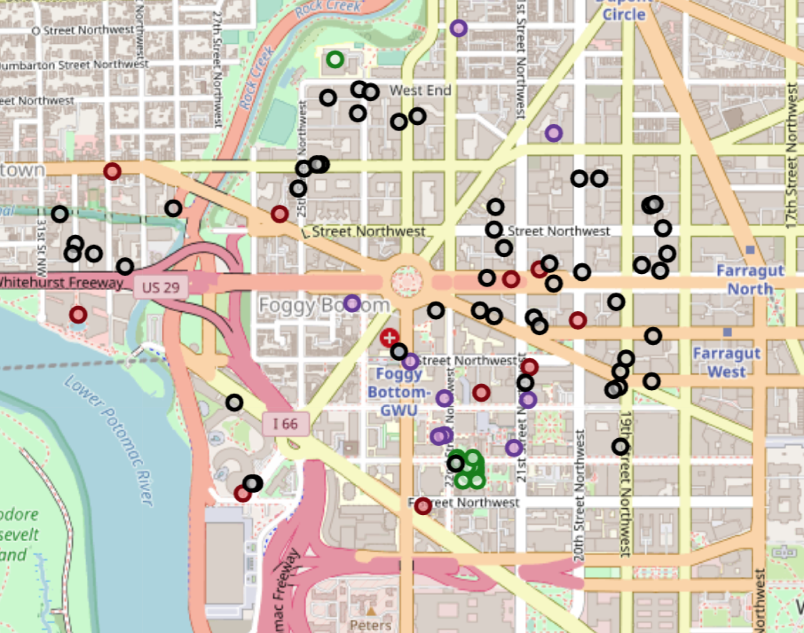
Results
From the weighted sums, we determined that Foggy Bottom would be the best location to open the Pizza place

Slide 6
Conclusion
Answer to the Business problem: Foggy Bottom is the best location to open a pizza place.
The findings of this project will help the relevant stakeholders to capitalize on the opportunities on high potential locations in their decisions to open a new pizza place.

Slide 7

Thank you!

